Slide 1

Project-1 Simple GUI Calculator
Presented by Submitted To
PRIYANKA VERMA NEXTHIKES IT SOLUTIONS..

Slide 2
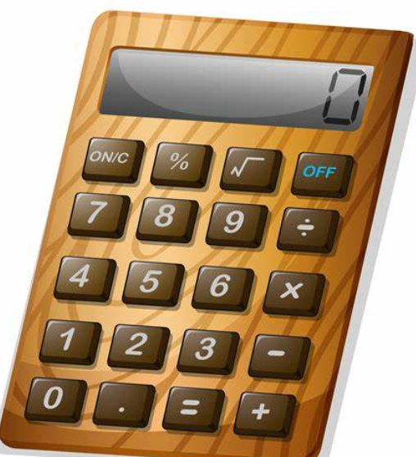
INTRODUCTION
A calculator is a basic utility to add, subtract, multiply divide and do other basic mathematical operations easily.
This GUI (Graphical User Interphase) based calculator is created using by Tkinter library .This library give us freedom to create many kind of widgets to design a smart and attractive GUI web application. In this GUI calculator all its operators and numbers are represented graphically and once we click it and use it as per our requirements .

Slide 3
What I Learnt ?
Technical Learning
Python programming
Visual Studio Code
General Learning
How to design and implement coding skills.

Slide 4



METHODS
Install Python
Install VS CODE (IDE)
Import Tkinter library

Slide 5
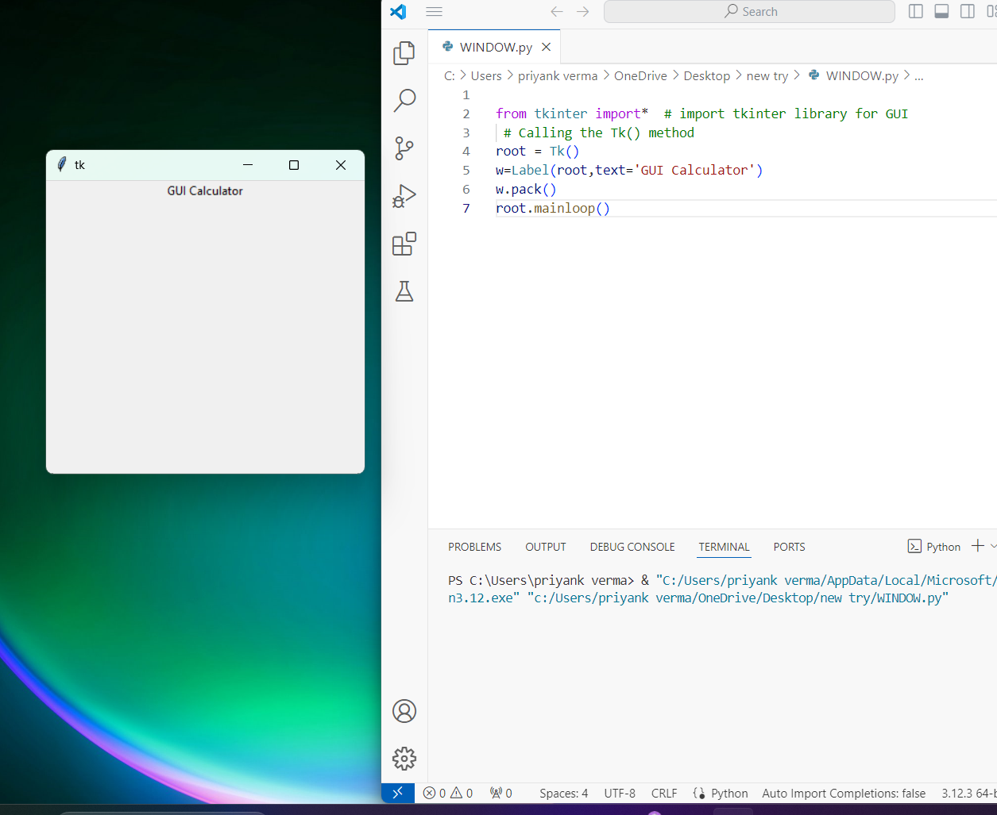
STEP 1
To create the calculator we need to import a GUI(Graphical User Interface) library “ tkinter “on our system. The tkinter Module provides all the basic functionality for creating graphical user interfaces. By the following syntax :-
from tkinter import *
root=Tk()
root. mainloop()
Next we create a GLOBAL VARIABLE called “expression” which will store the result of the calculation.
expression = “ “

Slide 6
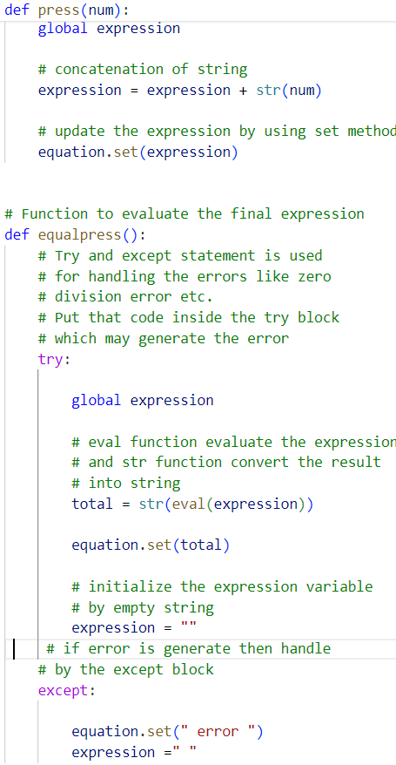
STEP 2
Now we need to create two functions to update evaluate the expression like
def press ( )
def equalpress ( )
set ‘ try and except block for error handling.’
Finally we write the DRIVER CODE to initialize and manage our GUI window.

Slide 7
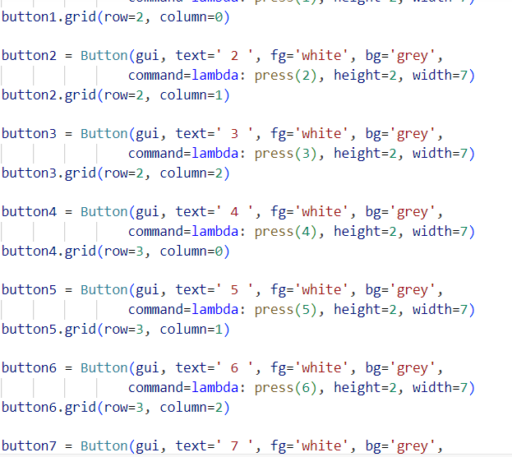
STEP 3
Next we need to create a Table like structure in which our widgets will be placed.
We use grid method which takes three arguments :--
expression_ field.grid (columns pan, ipadx ,ipady, rowspan)
Above parameters specify how many columns wide how many rows high and how many columns per row respectively should be used in our table layout .
Here we create buttons from 0 to 9 and some arithmetic operators like
+,-,/,* and =, . ,(,),clear.

Slide 8
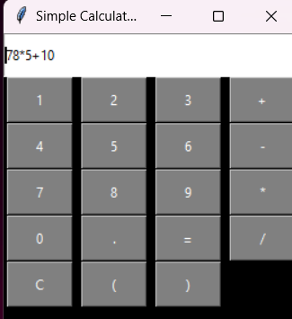
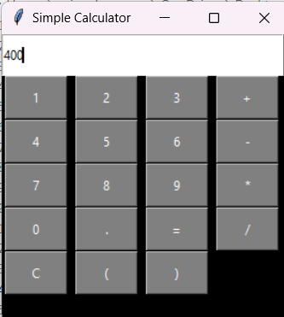
Ready To Use
Operational Task
Result

Slide 9
CONCLUSION
In creation of my GUI Calculator I used tkinter library .This library have many functions will make easy to design GUI Calculator. Here I got the experience GUI based designing which make our project more attractive visualization . This kind of GUI applications perform their arithmetic operations much faster than manually hence they save time as well as give accuracy also .It is very helpful for our end users - Professional office worker, Desktop users, Students.

Slide 10
Thank You

